Slide 1
Production Engineering
Course 1: Introduction to Production Engineering

Slide 2
Who are we?
Cristina Baciu – Adobe Analytics
Cristina Șerban – Adobe Pass
Alexandru Oporanu – Adobe Analytics
Alin Grigorescu – Adobe Pass
Andrei Moiceanu – Adobe Pass
Cristian Mărgineanu – Adobe Pass
Mihai Balan – Adobe Identity Services
Victor Grigoriu – Adobe Analytics

Slide 3
Course structure
Course (2h / week) | Lab (2h / week)
1. Introduction to Production Engineering | 1. Introduction. Building teams
2. Architecture, infrastructure & technologies | 2. Local setup, getting familiar with the code & process
3. Development environments. Minimum Viable Product (MVP) | 3. Features implementation
4. Software testing – overview | 4. Test implementation: unit, functional, end-to-end
5. Software testing – deep dive | 5. Test implementation – continued
6. Continuous Integration / Delivery (CI / CD), part 1 | 6. CI / CD setup: Continuous Integration
7. Continuous Integration / Delivery (CI / CD), part 2 | 7. CI / CD setup: Continuous Delivery
8. Observability & monitoring | 8. Monitoring
9. Metrics and KPIs | 9. Alerting
10. Conclusions | 10. Final assessment

Slide 4
Lab setup
Teams of 3-4 people
It’s not about just the implementation:
Getting out of your bubble and truly working as a team
Learning to listen for better communication
Reconciling different perspectives into constructive solutions
Navigating conflict
Managing time
Notes:
Old notes:
Teams of 3-4 people
Sets you up for future success – there are very few career paths that operate in isolation
Different perspectives, but constructive solutions
Conflict solving solutions
Time management – set manageable goals, meet deadlines
Communication - listening

Slide 5
Final scoring
Course attendance: 30% (split evenly between the 9 courses)
Lab activity: 50%
Each lab gets 0-10 points
Maximum 10p when presented on time
Maximum 8p when presented the next week
Final project: 10%
Final presentation: 10%
Notes:
Class attendance
30%
9 classes (present or absent)
Laboratory activity
(0p – 10p per lab)
50%
The lab can be presented the week after for 10p or 2 weeks after for 8p
Final Project
10%
The final implementation of all labs (0p - 10p)
Final Presentation
10%
It may include a .ppt or not. We evaluate the collaboration inside the team as well (0p-10p)

Slide 6
Why Production Engineering?

Slide 7
Prerequisites
Write reasonably complex code in at least one language / framework
Write tests for said code
Build a docker image
But there’s a lot more to it…

Slide 8

Story time | Building a new feature
Context:
A big software engineering company
You’re a developer in a team that owns a subscription-based SaaS* product
The product is already a very large system
Many teams are building features for it
* SaaS: Software as a Service. Think Netflix, Amazon, Hulu

Slide 9

Story time | Building a new feature
The plot:
You’re assigned a new feature in the product
A recommendation service to suggest customers what TV series to watch next
The action:
You start working
After a few weeks of coding the code is done
The recommendation service is ready to be released to customers (deployed to production)

Slide 10

Story time | Building a new feature
Deploying to Prod, take 1:
Deployment FAILS
The service requires frameworks and libraries which are not available in the production environment
Easy fix: you add the necessary libraries and try again

Slide 11

Story time | Building a new feature
Deploying to Prod, take 2:
Service CRASHES
You debug
The team managing the APIs for searching through TV series made some changes after you started coding your feature
The service is not passing all the required API parameters
Easy fix: add missing parameters
Deploy again

Slide 12
Story time | Building a new feature
Deploying to Prod, take 3:
Service RUNS but returns NO DATA
There are no recommendations, the service always returns an empty list
Investigating requires detailed logs, but service only has out-of-the-box logs
Easy fix: add detailed logs and enable logging
Deploy again
Errors start pouring in

Slide 13

Story time | Building a new feature
Deploying to Prod, take 4:
Service RUNS. Still NO DATA, but a lot of errors in the logs
The service expects a different data format for TV shows scores and fails at runtime when parsing the API response
Fix is non-trivial, but you pull it off in a couple of hours
Deploy again: everything works!
You’re out for the day

Slide 14
Story time | Building a new feature
Day 2, just another workday:
You start work on your next task
But client complains start coming in
Customer Support assigns one of the high priority tickets to you: Client complains streaming service is slow to load (sometimes)
You check, find nothing suspicious
You close the ticket, blaming it on a client-side network problem
You finish your other tasks and log off

Slide 15
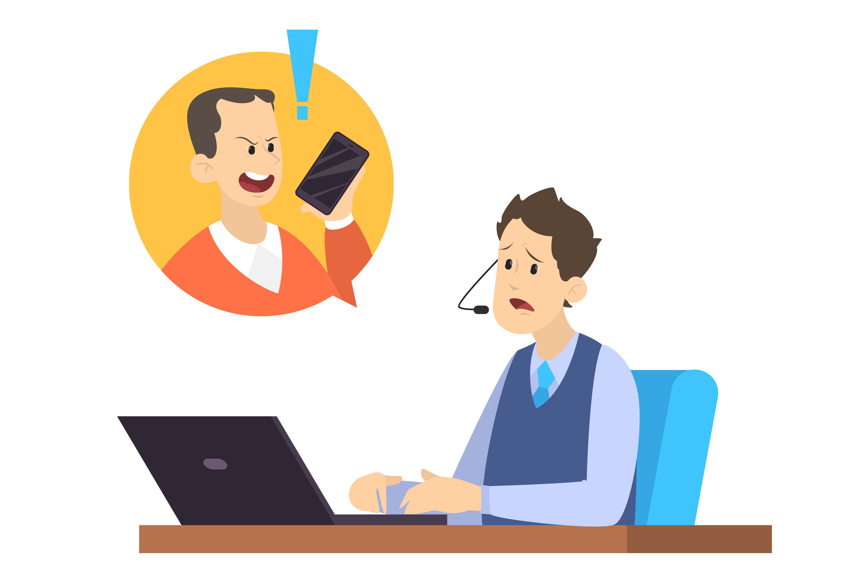
Story time | Building a new feature
Day 3, NOT just another workday:
You get a call in the morning as client requests are pouring in:
Slow loading time for the streaming service
Noticeable uptick in cancelled subscriptions due to ~1 day of service unavailability
All teams assemble to trace the root cause of the problem
The recommendation feature is the root cause: the streaming service is slow to load as it waits for recommendations
Recommendation service has no monitoring, so you’re in the dark
You add metrics to the code and redeploy with monitoring

Slide 16
Story time | Building a new feature
Day 3, (still) NOT just another workday:
Having got metrics out of a couple more hours of degraded service, you narrow it down to the database:
Every output of the recommendation service is stored for more accurate future feedback
After two days in production the database has too much data and all queries are slow
You have not load tested your feature before releasing it to prod
Possible fixes: either minimize the data or change the database
Neither is trivial and has far-reaching consequences for the service

Slide 17

Story time | Building a new feature
Day 3, (still) NOT just another workday:
A decision is made:
The streaming service is rolled back to a previous version and the recommendation feature is removed
Clients can use their accounts again. Problem “solved”!
Conclusions:
You’ve worked one month on a feature you were so proud of, that’s now disabled
All you got was: unhappy users, bad PR and a lot of lost money (in cancelled subscriptions)

Slide 18

Story time | Building a new feature
Definitely NOT a success story
Surely, no one will be promoted because of it
For software companies (and especially SaaS companies), client experience is paramount
If the client is not happy, it doesn’t pay. It clients don’t pay, the company can’t succeed
How to avoid such stories?
Change the software development process to ensure we get the best client experience

Slide 19
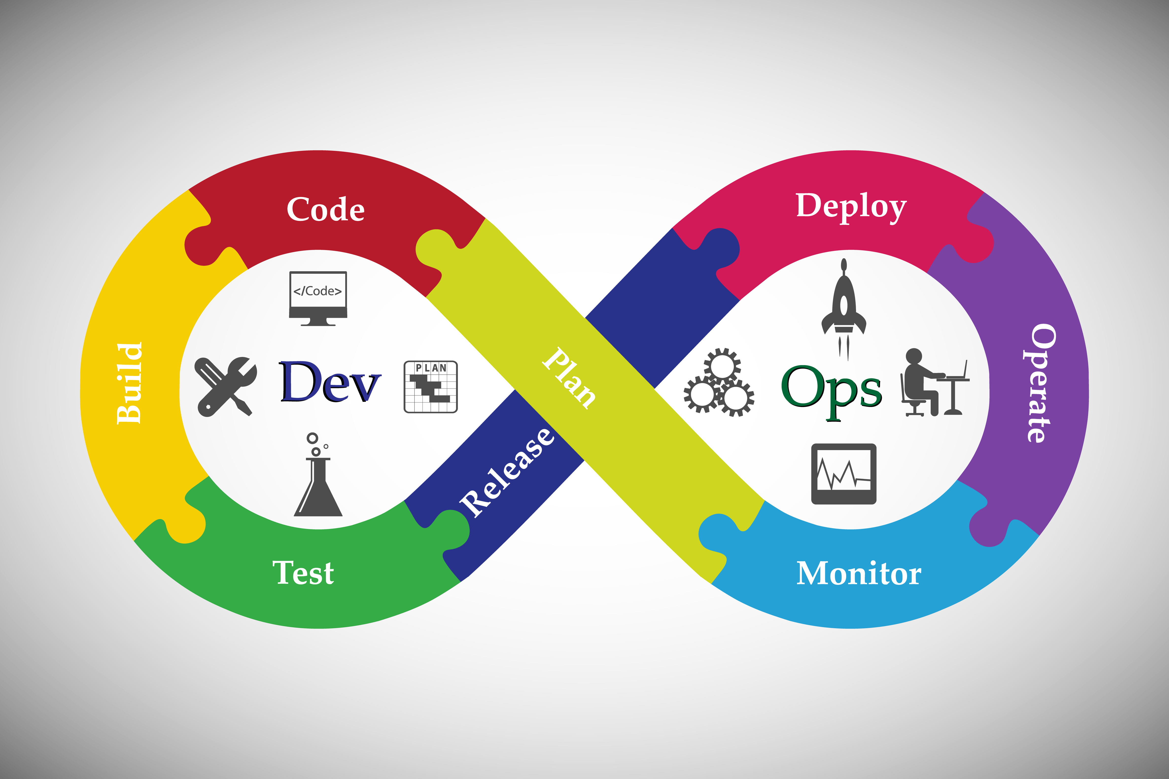
Story time | Building a new feature
A feature is not done when the code is functionally implemented and works on your machine
Being done also requires:
Tests to catch issues with the code itself (unit) and when integrated with other services (integration)
Meaningful logs and relevant metrics to explain runtime behavior
End-to-end tests to quickly exercise production flows and discover bad deployments
Alerts defined so problems are investigated before clients even notice
Documentation for operating and debugging in production

Slide 20
Course sneak peek

Slide 21
Course sneak peek
We built this course around the methodology of building software, starting from the code being written to having it running in production
We will use examples from the Software-as-a-Service (SaaS) domain
Most of the points are valid for other domains and types as software, too
We will go through all the necessary steps to take an idea to production

Slide 22
Course sneak peek
So, you want to implement a new feature
You open your computer. You start coding. The required functionality is implemented
The software runs on your machine. You can demo the feature running locally
Is this all? Is it done? Can you move to the next project? It depends:
Is the feature part of a university homework/project? Then probably yes
Is the feature part of a larger software that people pay for? Then surely no. Done means a lot more than just having the code run successfully on a local machine
This course will take you through the steps needed to move a feature from idea to releasing it in production. The end goal is having clients use it successfully

Slide 23
Course sneak peek | Architecture, infrastructure, technology
We start with discussing the prerequisites of any software project:
The technologies and software frameworks
The desired architecture
The target infrastructure
Why is software architecture important?
It defines the software components needed to achieve the goal
It defines how the software components will interact
E.g. if using micro-services, interactions are API-based. APIs need to be well-defined and reliable
E.g. if using publish-subscribe, interactions are message-based. Message exchange must be reliable and efficient

Slide 24
Course sneak peek | Architecture, infrastructure, technology
Why are frameworks and technologies important?
Each framework or technology has advantages and disadvantages
In choosing one over another, one must be aware of the trade-offs
It’s better for the technology stack to be aligned with the larger software context of the product
E.g. if the rest of the product uses Java with Spring Boot, it may not make sense to write new services in Python with Flask

Slide 25
Course sneak peek | Architecture, infrastructure, technology
Why is the targeted infrastructure important?
Choosing an infrastructure comes with constraints and tradeoffs
Deployment format (native executable, container image, code dump)
Deployment latency (from a couple of minutes to a couple of hours)
Deployment pipeline complexity (from upload & deploy, to full scripted infrastructure deployment)
Target infrastructure flexibility (from locked-down app servers to full host control)
Notes:
Running the code in virtual machines provides maximum control over the entire stack, but increases deployment complexity and latency
If the target infrastructure is container-based
If the target infrastructure is a Platform-as-a-Service (PaaS) provider,

Slide 26
Course sneak peek | Development environment
Why is the development environment important?
It’s the place where you write your code
You should be able to perform any non-production testing on it
Test integration with other services
Perform some load testing
It should look as close as possible to production
When your code reaches production, you can be confident it won’t blow up in flames

Slide 27
Course sneak peek | Continuous Integration & Continuous Delivery
Why is continuous integration (CI) important?
To ensure the code always works, we need continuous integration
Validate the code continuously
Use-case: your code works today, but another teams makes a change to an API or data structure your code consumes
Running tests with every change can prevent such changes to reaching customers

Slide 28
Course sneak peek | Continuous Integration & Continuous Delivery
Why is continuous delivery (CD) important?
After you implement a new feature, the clients should be able to use it as soon as possible
Once it's done it should be running in production as well
If it's feature code then it should be used by clients and help the business move forward
Continuous delivery ensures code can be shipped quickly
Small changes get pushed to Production at once, automatically
Smaller changes decrease the chance of failure

Slide 29
Course sneak peek | Logging and monitoring
Why is logging and monitoring important?
Tells you how the application performs when it’s live and used by clients
Helps you understand why it crashes and how (when it does)
Helps investigate client complains
Notes:
Example: If client-perceived latency is bad, i.e. your system is slow. You need to investigate which component introduces latency

Slide 30
Course sneak peek | SLA, SLO, SLI
SLA: Service Level Agreement
The contract between the company and the customer
Specifies the performance, quality and uptime of the system
SLO: Service Level Objective
The individual values specified in the SLA are the objectives
SLI: Service Level Indicator
To fulfill your objectives, you monitor and measure different metrics (indicators)

Slide 31
Questions?

Slide 32

